Slide 1
QUALIFICATIONS BASED SELECTION CE 4200 Professional Engineering Practice Issues
Spring 2022 Semester
William D. Lawson, P.E., Ph.D.

Slide 2
VOCABULARY
QUALIFICATIONS BASED SELECTION
Professional Engineering Practice Issues

Slide 3
procurement
DBB
QBS
Alternative Project Delivery
Project Delivery
FBS
RFQ
RFP
Proposal
SOQ

Slide 4
PROCUREMENT
Procurement is purchasing or otherwise acquiring any supplies, services, or construction; includes all functions that pertain to the acquisition, including description of requirements, selection, and solicitation of sources, preparation and award of contract, and all phases of contract administration.
Source: NIGP- The Institute for Public Procurement

Slide 5

EXAMPLE ONLY: I do not know the procurement process for this project.
Buddy Holly Hall of Performing Arts and Sciences

Slide 6
Project delivery method
A project delivery method is a system designed to achieve the satisfactory completion of a construction project from conception to occupancy.
Source: CMAA- Construction Management Association of America

Slide 7
Alternative project delivery methods
Alternative Delivery Methods [may be divided] into three basic categories: Design-Bid-Build (DBB), Construction Management At Risk (CMAR), and Design-Build (DB).
Source: CMAA- Construction Management Association of America

Slide 8
Design-bid-build, dbb
Design-Bid-Build (DBB) is the traditional U.S. project delivery method, which customarily involves three sequential project phases: design, procurement, and construction.
QBS
MOST HIGHLY QUALIFIED
Source: DBIA- Design-Build Institute of America

Slide 9
Qualifications based selection, QBS
QBS
MOST HIGHLY QUALIFIED
Qualifications-Based Selection (QBS) is a procurement process for the competitive selection of architectural and engineering services under which the most appropriate professional or firm is selected based on qualifications such as knowledge, skill, experience, and other project-specific factors, rather than on fees.
Source: NIGP- The Institute for Public Procurement

Slide 10
fee based selection, fBS
FBS
LOWEST FEE
Fee-Based Selection (FBS) is a procurement process for the competitive selection of architectural and engineering services under which the most appropriate professional or firm is selected based on …fee.
Source: NIGP- The Institute for Public Procurement

Slide 11
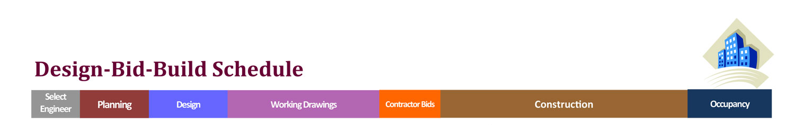
TRADITIONAL PHASES OF AN ENGINEERED PROJECT
DESIGN PHASE
BID
CONSTRUCTION PHASE
QBS
MOST HIGHLY QUALIFIED
FBS
LOWEST FEE
REQ’D
FOR PUBLIC WORK
ALLOWED
FOR PRIVATE WORK

Slide 12
Request for qualifications, RFQ
QBS
MOST HIGHLY QUALIFIED
REQ’D
FOR PUBLIC WORK
An RFQ (Request for Qualifications) is a request for firms to submit their qualifications to be considered for a project. It is applicable for professional services…
Source: Shive-Hattery Architecture+Engineering

Slide 13
Statement of qualifications, soQ
QBS
MOST HIGHLY QUALIFIED
REQ’D
FOR PUBLIC WORK
A/E firms with an interest in being considered for design services contracts must submit the required Statement of Qualifications... A completed SOQ furnishes general information on the size, capabilities, personnel, and past experience of an interested firm.…
Source: ACEC-American Council of Engineering Companies

Slide 14
Request for proposal, RFp
QBS
MOST HIGHLY QUALIFIED
REQ’D
FOR PUBLIC WORK
An RFP (Request for Proposal) is a request for firms to submit their proposal for a project.
Source: Shive-Hattery Architecture+Engineering

Slide 15
proposal
QBS
MOST HIGHLY QUALIFIED
REQ’D
FOR PUBLIC WORK
Engineering proposals are the industry standard document by which engineering consultant selection decisions are made. For engineering consulting firms, they are the primary method of securing new work.
Source: ProjectEngineer

Slide 16
TRADITIONAL PHASES OF AN ENGINEERED PROJECT
DESIGN PHASE
BID
CONSTRUCTION PHASE
QBS
MOST HIGHLY QUALIFIED
FBS
LOWEST
BID
REQ’D
FOR PUBLIC WORK
REQ’D
FOR PUBLIC WORK

Slide 17

QBS
MOST HIGHLY QUALIFIED
CONSTRUCTION CONTRACT
DESIGN TEAM SELECTION
FBS
LOWEST
BID

Slide 18
CONTEXT
QUALIFICATIONS BASED SELECTION
Professional Engineering Practice Issues

Slide 19

CEBOK3 Topic 20
“Professional Responsibilities”
The “Professional” outcomes
pp. 57-60

Slide 20
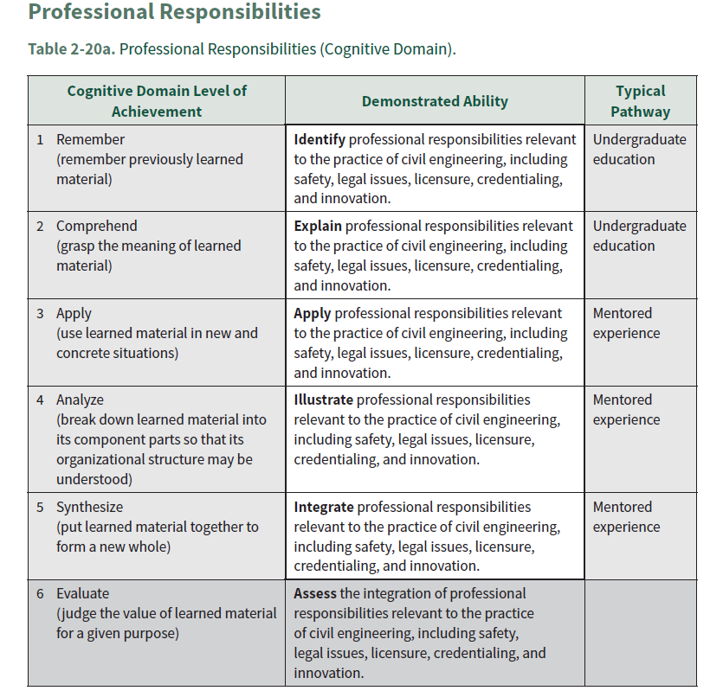
A PROFESSIONAL
RESPONSIBILTY

Slide 21
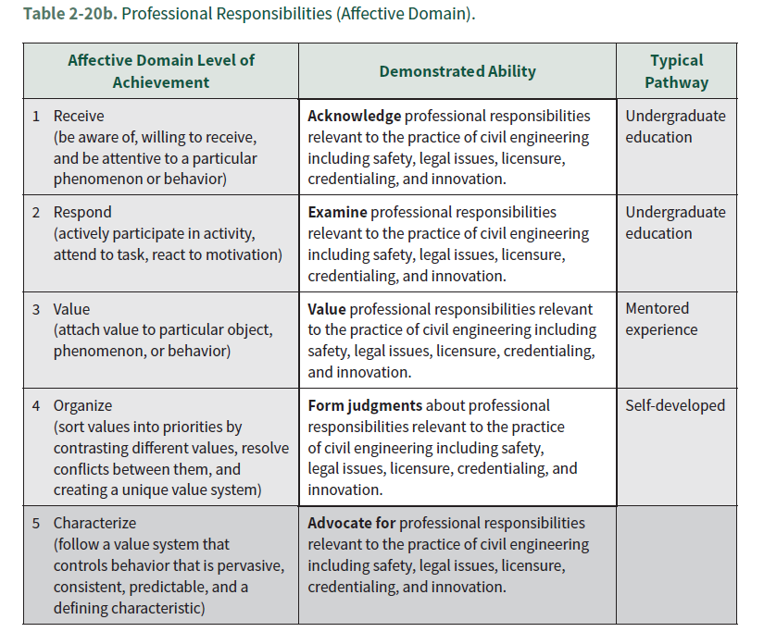

Slide 22

A LEGAL ISSUE

Slide 23
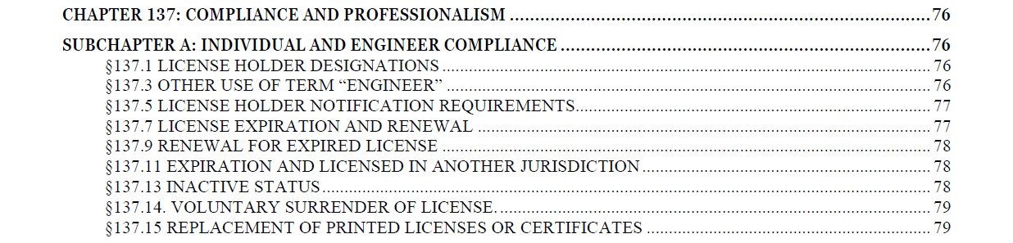
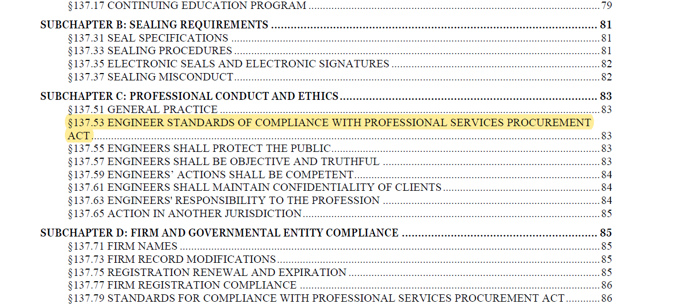

Slide 24
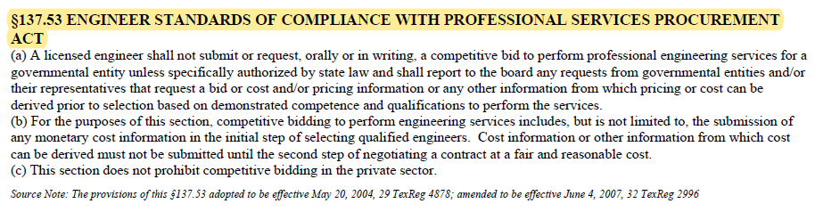

Slide 25
ENFORCEMENT PROCEEDINGS SANCTIONS AND PENALTIES

Slide 26
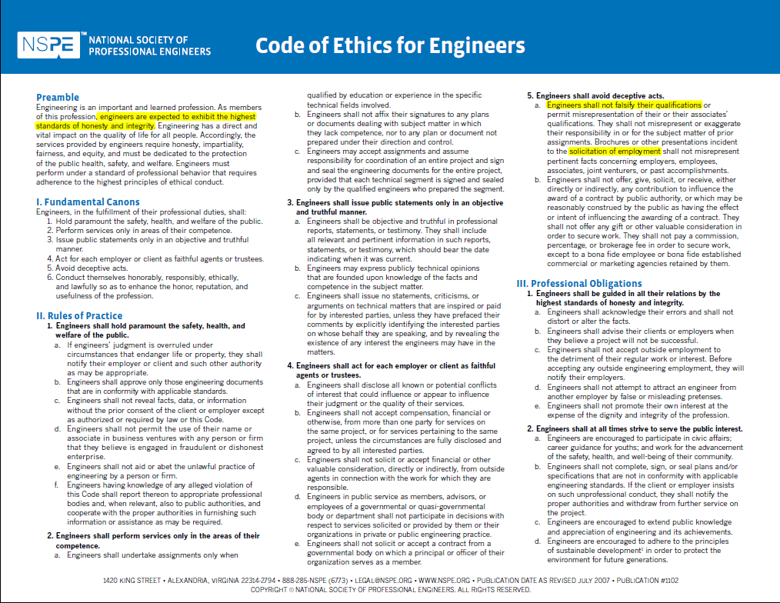
AN ETHICAL ISSUE

Slide 27
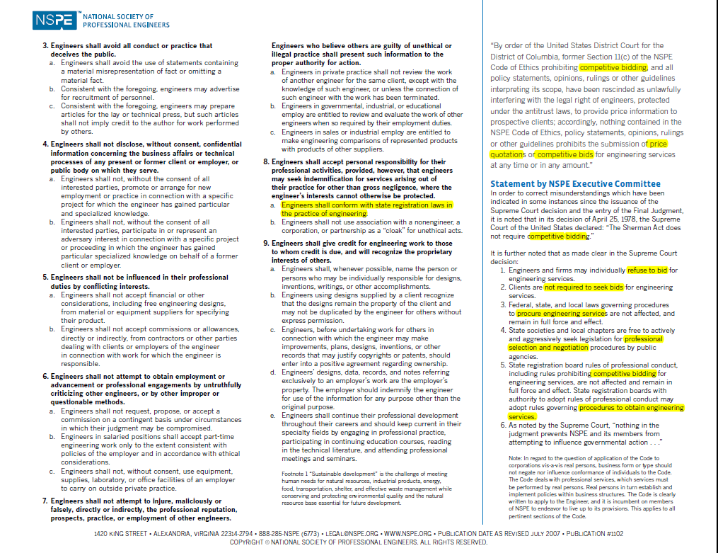

Slide 28

Spiro T. Agnew Vice President of the United States Governor, State of Maryland
AN HISTORICAL ISSUE

Slide 29
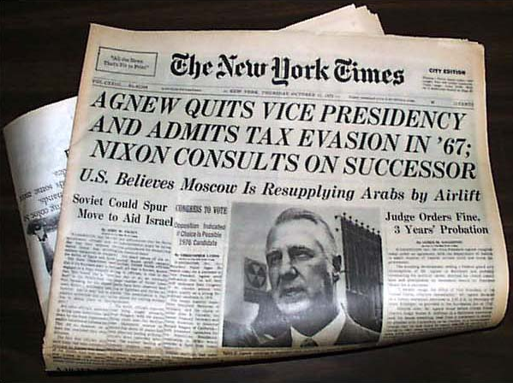

Slide 30
Notes from the Historical Record Agnew took hundreds of thousands of dollars in contractors' kickbacks… Envelopes filled with cash given to him in his office detailed in 40-page report
“When Spiro T. Agnew arrived in the dark-paneled fifth-floor courtroom in the old Federal Courthouse on Calvert Street on Oct. 10, 1973, no one anticipated what was coming: resignation as Vice President and a plea of no contest to tax evasion.
As part of the plea agreement that spared Agnew a prison term, U.S. Attorney General Elliot L. Richardson read a 40-page exposition detailing how Agnew had extorted hundreds of thousands of dollars from government contractors [consulting engineers] -- cash in white envelopes -- while he served as Baltimore County executive, Governor of Maryland, and Vice President.
Source: The Baltimore Sun, September 19, 1996

Slide 31
WHY QBS?
QUALIFICATIONS BASED SELECTION
Professional Engineering Practice Issues

Slide 32

BESPOKE
“made to fit a particular [application] : CUSTOM-MADE”

Slide 33


THE NATURE OF ENGINEERING PROJECTS
OFF THE RACK? or
BESPOKE?
Most of the
Rest of Us
Neil Patrick Harris
“Barney Stinson”

Slide 34
The QBS Process
There are seven basic steps involved in pursuing design work under QBS:
Public solicitation for architectural and engineering services
Submission of a statement of qualifications to design specific projects for which public announcements were made
Evaluation of the statements of qualifications
Development of a short-list of at least three submitting firms in order to conduct interview with them
Interviews with the firms
Ranking of at least three of the most qualified firms
Negotiation with the top ranked firm.
Source: ACEC-American Council of Engineering Companies

Slide 35
Why QBS Works
Design professional firms do not sell a commodity, but provide technical expertise, innovation and the latest technology. These skills enhance the quality of a project and lead to cost savings. Simply stated, selecting an engineering firm based on low bid prevents an owner from receiving the best value.
Source: ACEC-American Council of Engineering Companies

Slide 36
Legal basis for QBS
QUALIFICATIONS BASED SELECTION
Professional Engineering Practice Issues

Slide 37
Public Law 92-582 (FEDERAL) 92nd Congress, H.R. 12807
In 1972, Congress adopted the Brooks Act (P.L. 92-582), requiring the use of Qualifications-Based Selection (QBS) for the procurement of architect and engineering services. The use of QBS ensures that federal agencies — and the taxpayer — receive highly technical architect and engineering services from the most experienced and most qualified firms at a fair and reasonable cost. QBS is used by all federal agencies, 46 state governments, and many localities throughout the country.
Source: ACEC-American Council of Engineering Companies

Slide 38
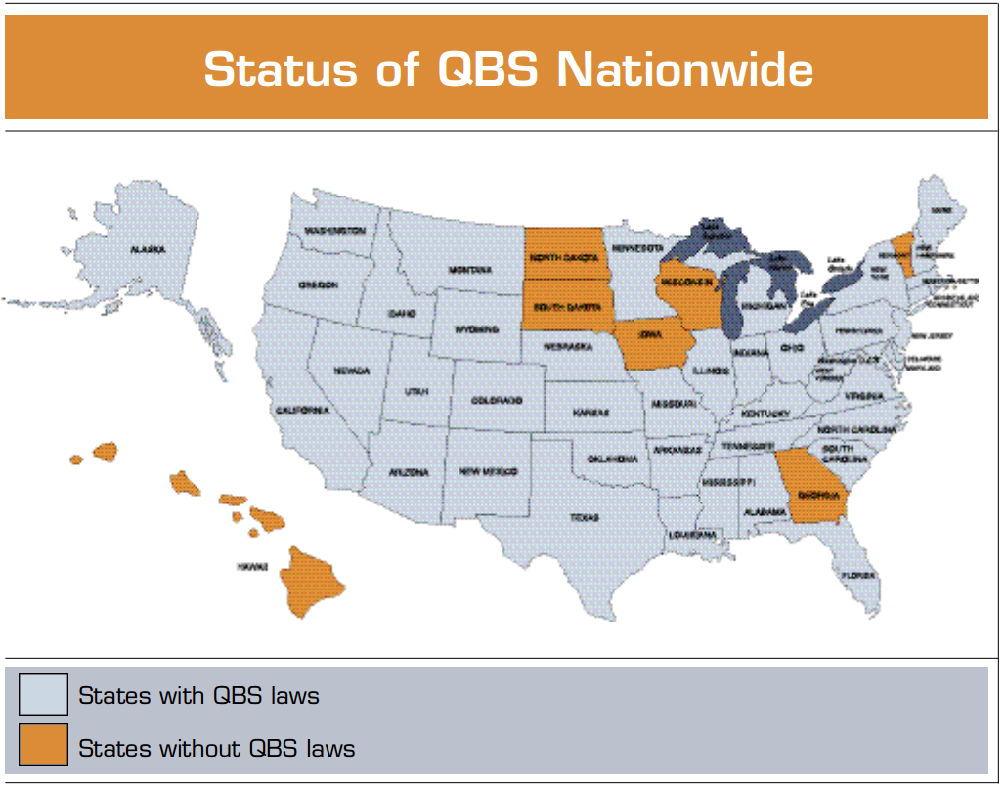
Source: Engineering Inc. (Dec 2002)

Slide 39

GOVERNMENT CODE (TEXAS)
TITLE 10. GENERAL GOVERNMENT
SUBTITLE F. STATE AND LOCAL CONTRACTS AND FUND MANAGEMENT
CHAPTER 2254. PROFESSIONAL AND CONSULTING SERVICES
SUBCHAPTER A. PROFESSIONAL SERVICES
Sec. 2254.001. SHORT TITLE. This subchapter may be cited as the Professional Services Procurement Act.
Added by Acts 1993, 73rd Leg., ch. 268, Sec. 1, eff. Sept. 1, 1993.
Sec. 2254.003. SELECTION OF PROVIDER; FEES.
(a) A governmental entity may not select a provider of professional services or a group or association of providers or award a contract for the services on the basis of competitive bids submitted for the contract or for the services, but shall make the selection and award:
on the basis of demonstrated competence and qualifications to perform the services; and
for a fair and reasonable price.
(b) The professional fees under the contract may not exceed any maximum provided by law.

Slide 40
Design services involve the exercise of professional judgment and creativity that are vital to a project’s success. Providers of such services must not be treated as commodities to be selected on the basis of lowest price.
Source: ACEC-American Council of Engineering Companies

Slide 41

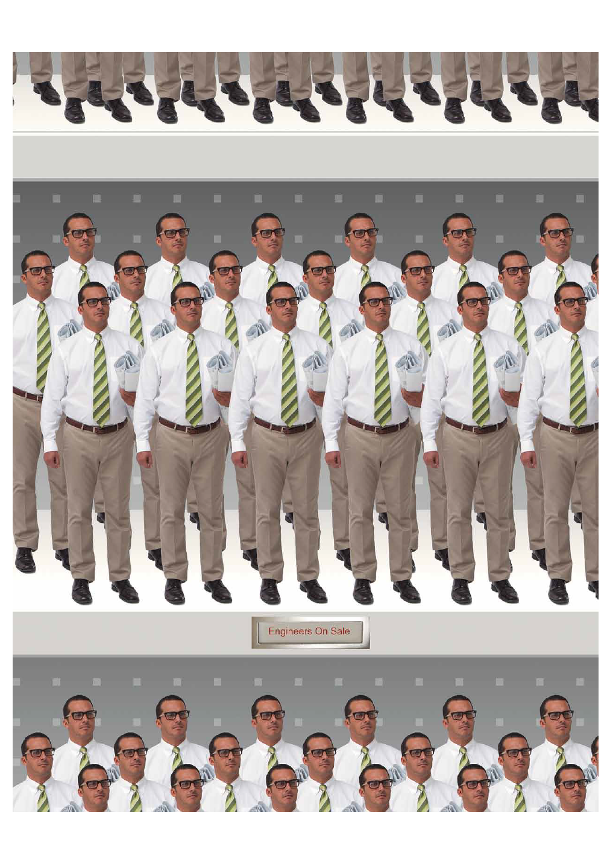
Source: ENGINEERING, INC. March/April 2015

Slide 42
THANK YOU.

